Slide 1

Dr Evil’s Revenge: CyberSizzle

Slide 2
Agenda
What is this?
Musical Chairs
Introduction
Briefing
Exercise Start
Hotwash

Slide 3
This is an exercise
We will be running through a narrative tabletop exercise that walks through the scenario as a table group
A full 3-hour experience
There is a 30-minute break!
Seats are limited! Please excuse yourself if unable to stay.

Slide 4
Musical Chairs!
Please stand and gather your belongings
There’s a “Hospital” and a “County” player set
If you want to be a controller stay in the middle

Slide 5
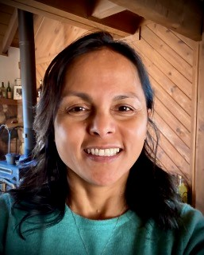
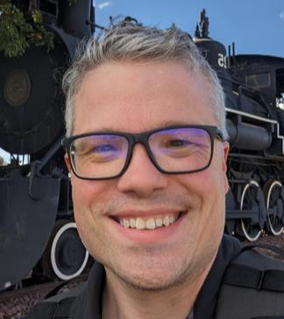
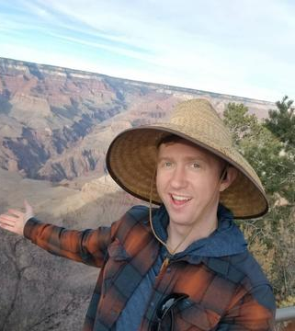
Coconino County Health and Human Services
Code Line Networks

Slide 6
Briefing
Get your phones out
QR code for the slide deck

Slide 7

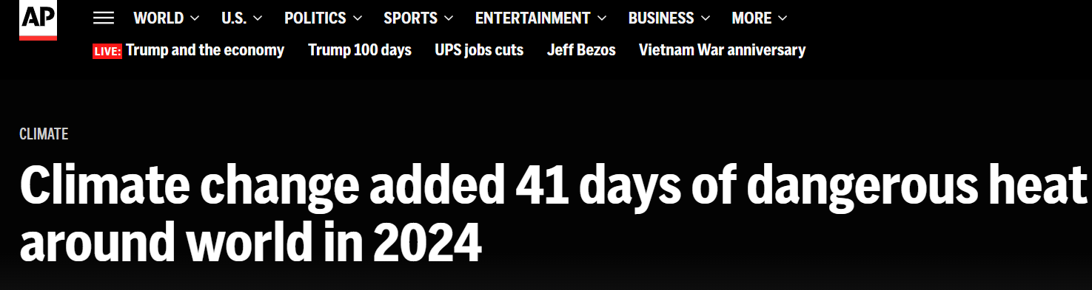
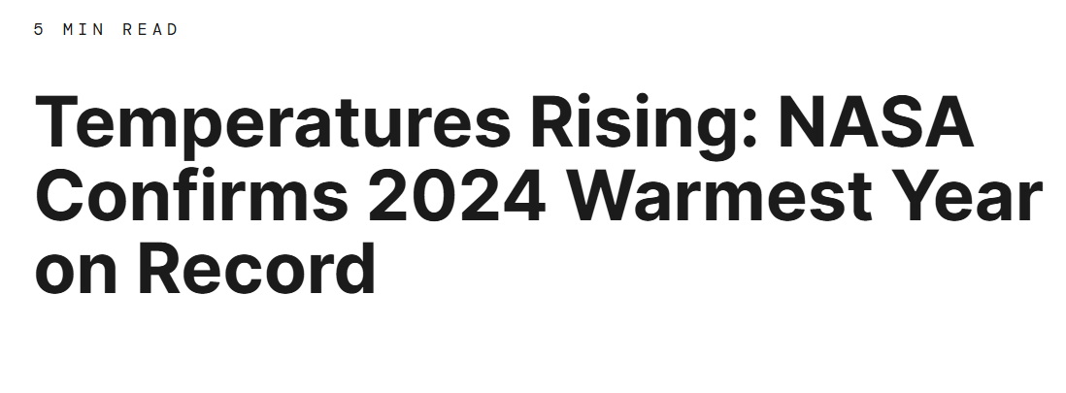
Why Heat?

Slide 8
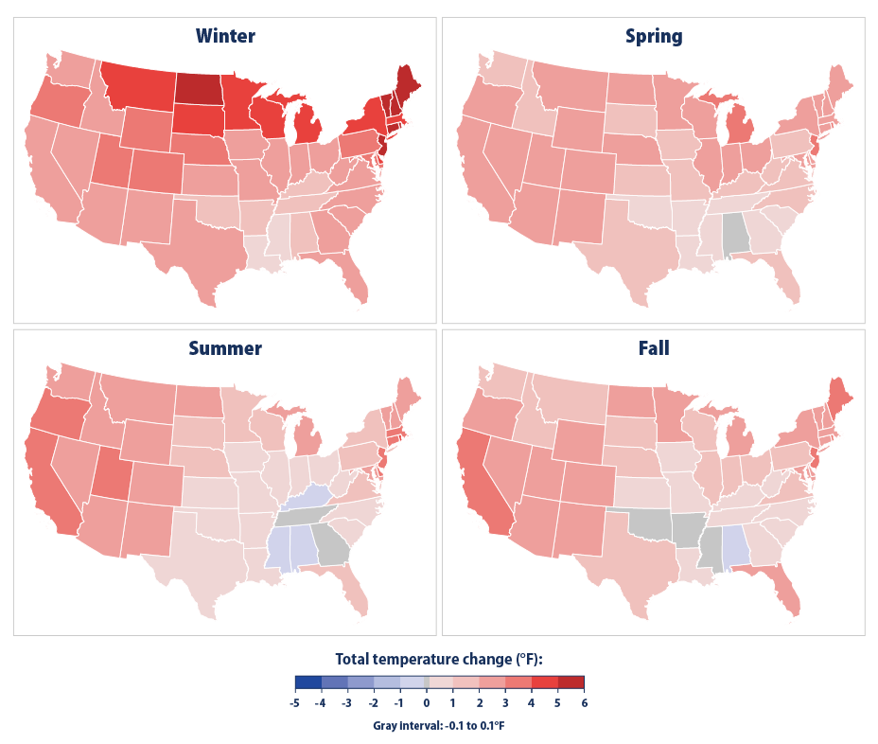
Change in Seasonal Temperatures by State, 1896–2023

Slide 9

Heat Relief Network – Arizona/Maricopa County
Respite Center
Cooling Center
Hydration Station
Collection and Donation Site

Slide 10
Heat Relief Network – Arizona/Maricopa County
Respite Center – Indoor, air-conditioned location that offers hydration and allows for uninterrupted rest, sitting, or lying down (depending on each facility) during hours of operation Examples: Places of worship or facilities with the ability to allow visitors reasonable rest options.
Cooling Center – Indoor, air-conditioned location that offers hydration. Example: Libraries or places of business that offer spaces to sit and distribute water.

Slide 11
Heat Relief Network – Arizona/Maricopa County
Hydration Station – Indoor or outdoor locations where individuals can go to receive bottled water and other collected donated items.
Collection & Donation Site – Water bottles can be donated here for use at heat relief locations and hydration stations. Some sites also accept other donations such as clothing, hats, and toiletries

Slide 12
Cyber
NEWS Stories about cyber
UCSD stories
Any delay in care will result in death when life is on the line (marathon paper)

Slide 13
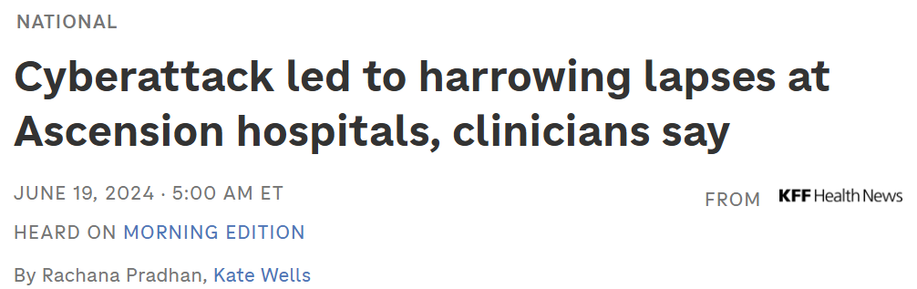
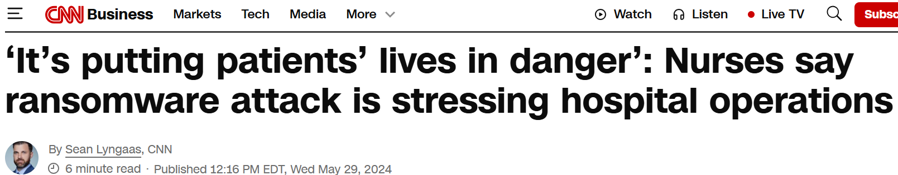
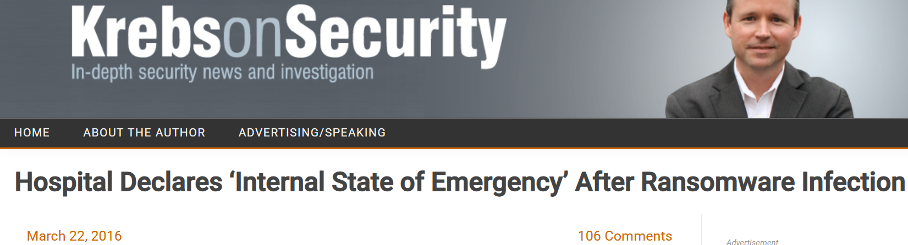

Slide 14
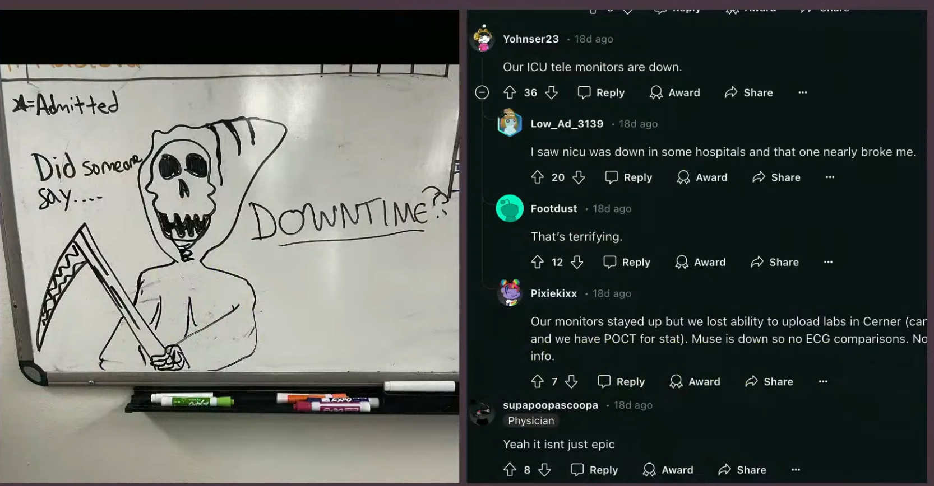
Source: Healthcare is in Intensive Care BsidesLV 2024 – Dr. Christian Dameff

Slide 15

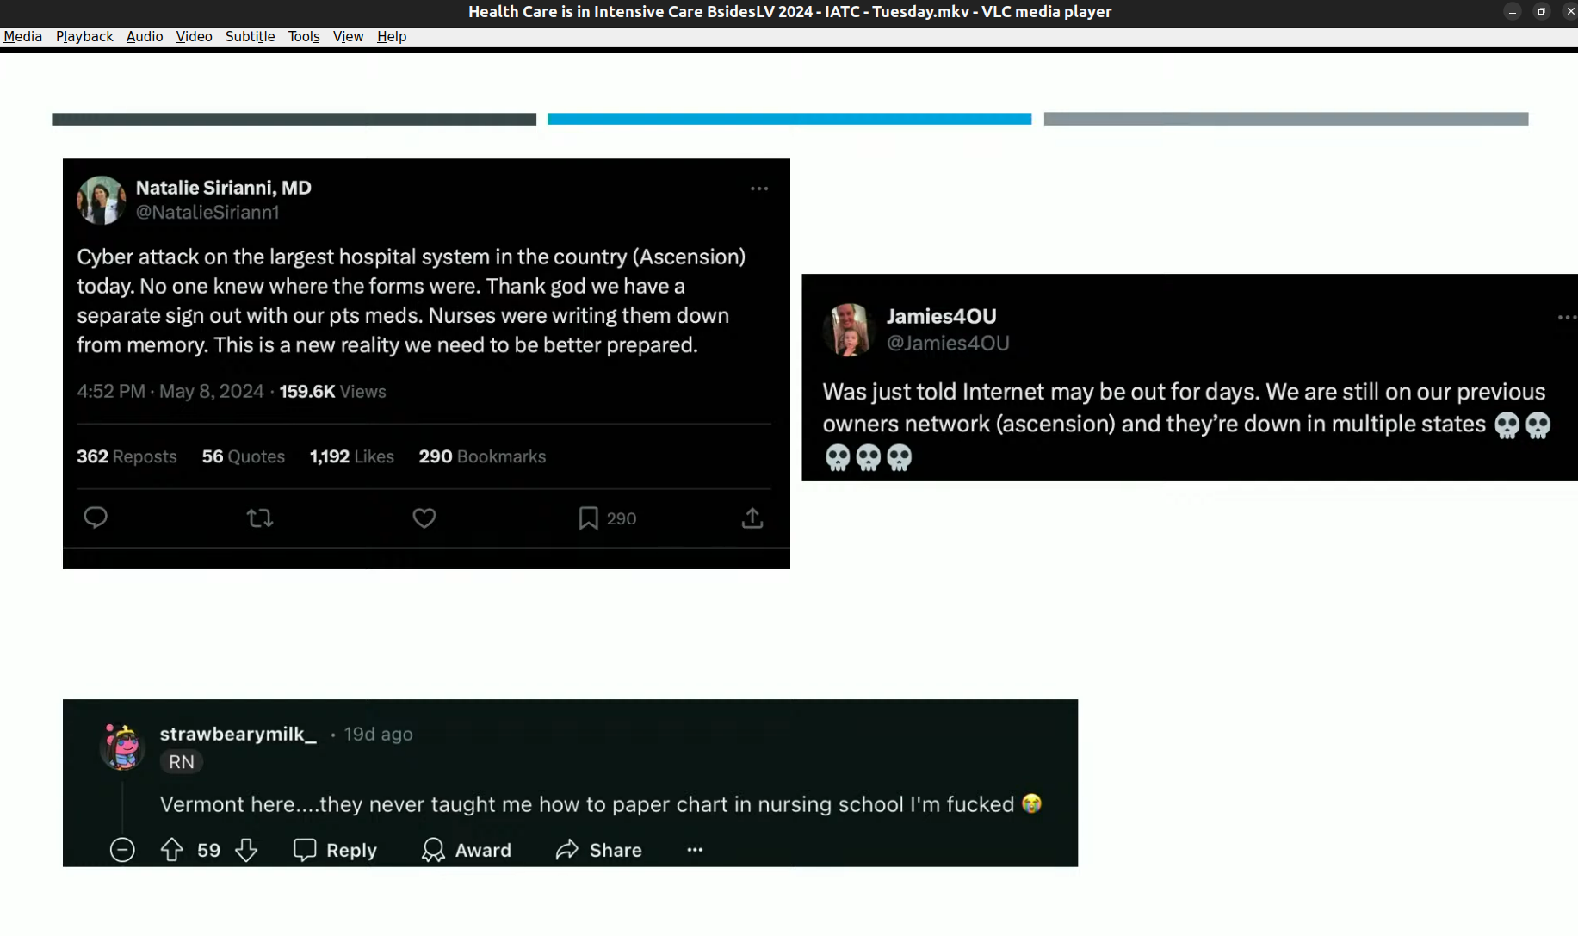
Source: Healthcare is in Intensive Care BsidesLV 2024 – Dr. Christian Dameff

Slide 16
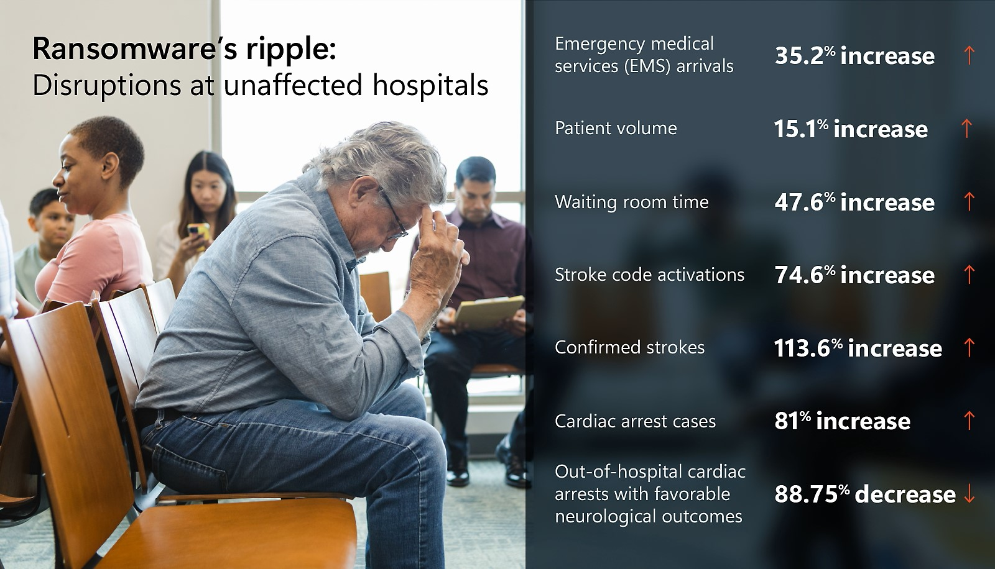
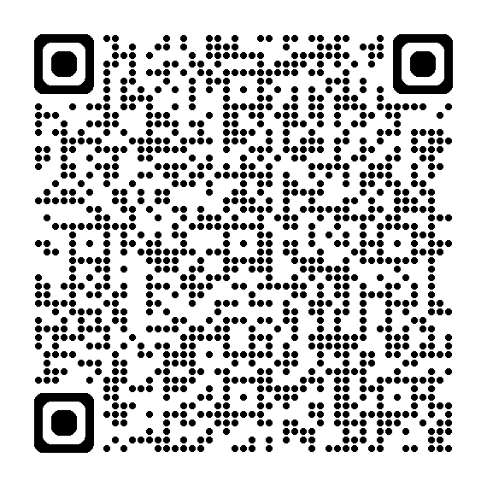

Slide 17
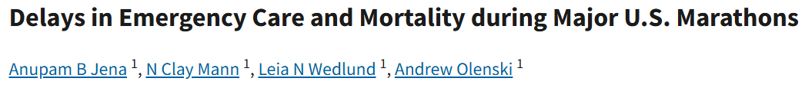
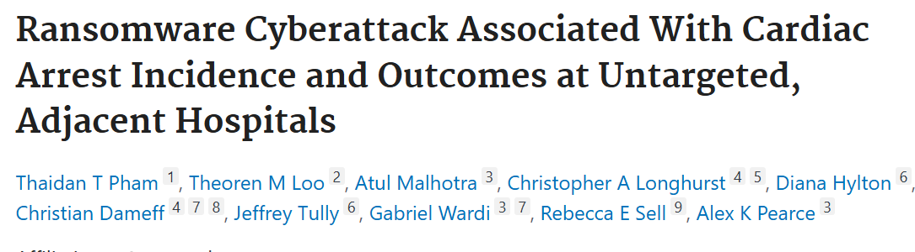


Slide 18
Cyber is three things
Cyber Outage
Information Outage,
Patient History Loss
Medical Surge
More Patients, Delayed Care
Mental Health
Stress on Staff, Patients

Slide 19
The future of response
Epidemiology of a cyber security
Ghost response networks (Crash Cart)
Mental health response

Slide 20

Exercise Start
This is a closed, high stress, and your fault environment
This Photo by Unknown Author is licensed under CC BY-SA-NC

Slide 21

Break

Slide 22

Exercise Continue

Slide 23
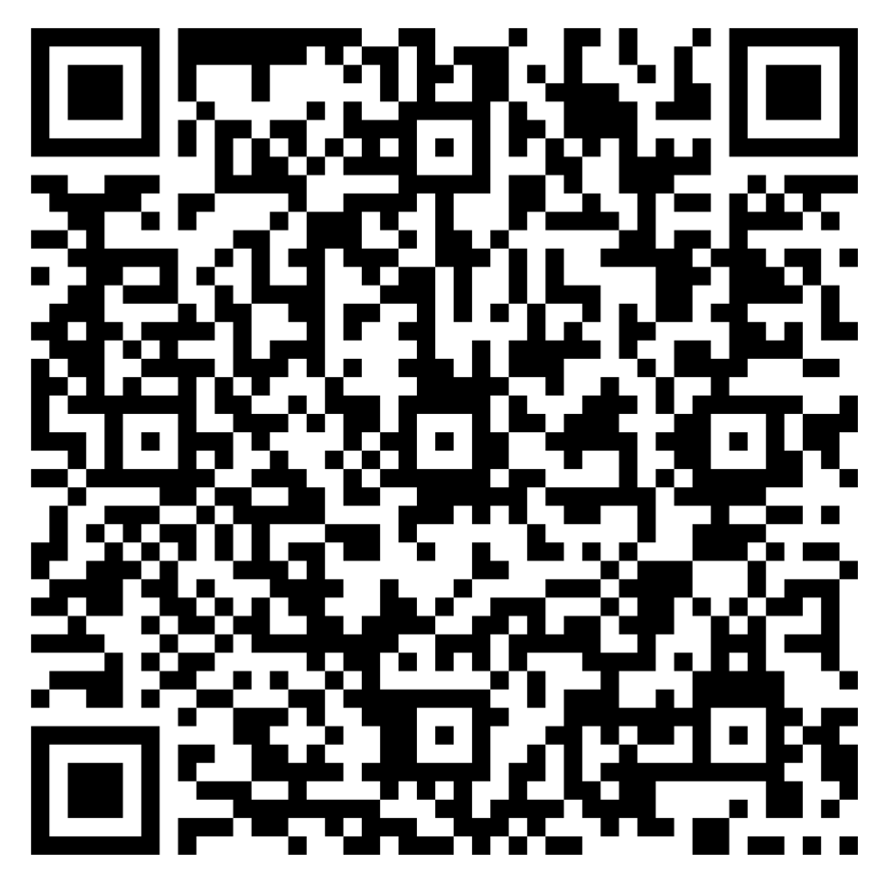
Hot Wash questions
What is your biggest take away?
Please state your name
Organization, Role there
Say if controller or player

Slide 24
Hot Wash questions
Overall, how satisfied are you with the event?
Please state your name
Organization, Role there
Say if controller or player

Slide 25
Hot Wash questions
What did you like most about the event?
How could the event be improved?
Please state your name
Organization, Role there
Say if controller or player

Slide 26
Thank you – Rate us on the conference app!
Contact information:
Blake Scott, bscott@coconino.az.gov
Tricia Topasna, trtopasna@coconino.az.gov
Scott Fraser, scott@codelinenetworks.com

